Slide 1

Customer Shopping Behavior Analysis
Analyzing 3,900 transactions across product categories to uncover spending patterns, customer segments, and strategic opportunities.

Slide 2
Dataset at a Glance
3,900
18
Transactions
Features
Rows in the dataset
Columns of data
$59.76
3.75
Avg Purchase
Avg Rating
Average spend per order
Average review score
Key features include customer demographics, purchase details, shopping behavior, and subscription status. Only 37 values were missing — all in the Review Rating column.

Slide 3

Data Preparation in Python
01
Load & Explore
Imported dataset with pandas; used df.info() and describe() for structure and stats.
02
Clean Missing Data
Imputed 37 missing Review Ratings using median rating per product category.
03
Engineer Features
Created age_group and purchase_frequency_days; dropped redundant promo_code_used.
04
Load to Database
Connected to PostgreSQL and loaded the cleaned DataFrame for SQL analysis.

Slide 4
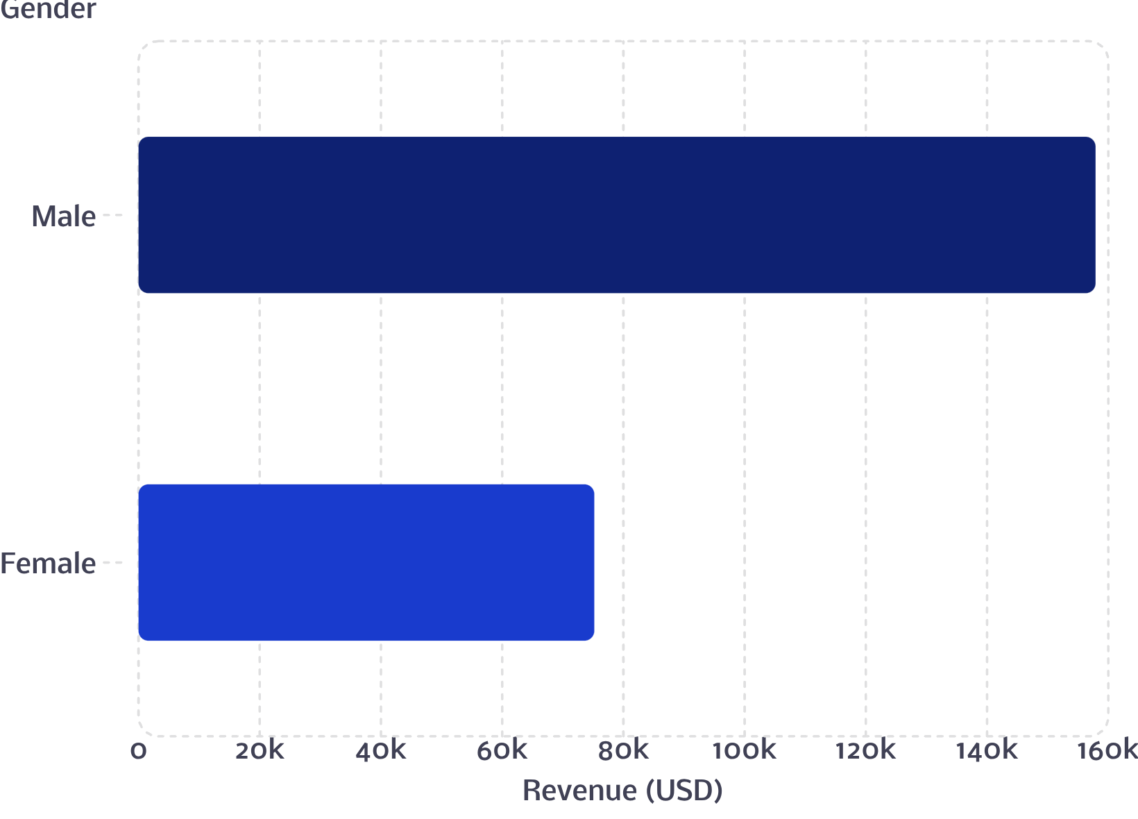
Revenue by Gender
Key Insight
Male customers generated $157,890 in total revenue — more than double the $75,191 from female customers.
This suggests a significant spending gap worth exploring through targeted marketing and product recommendations.

Slide 5
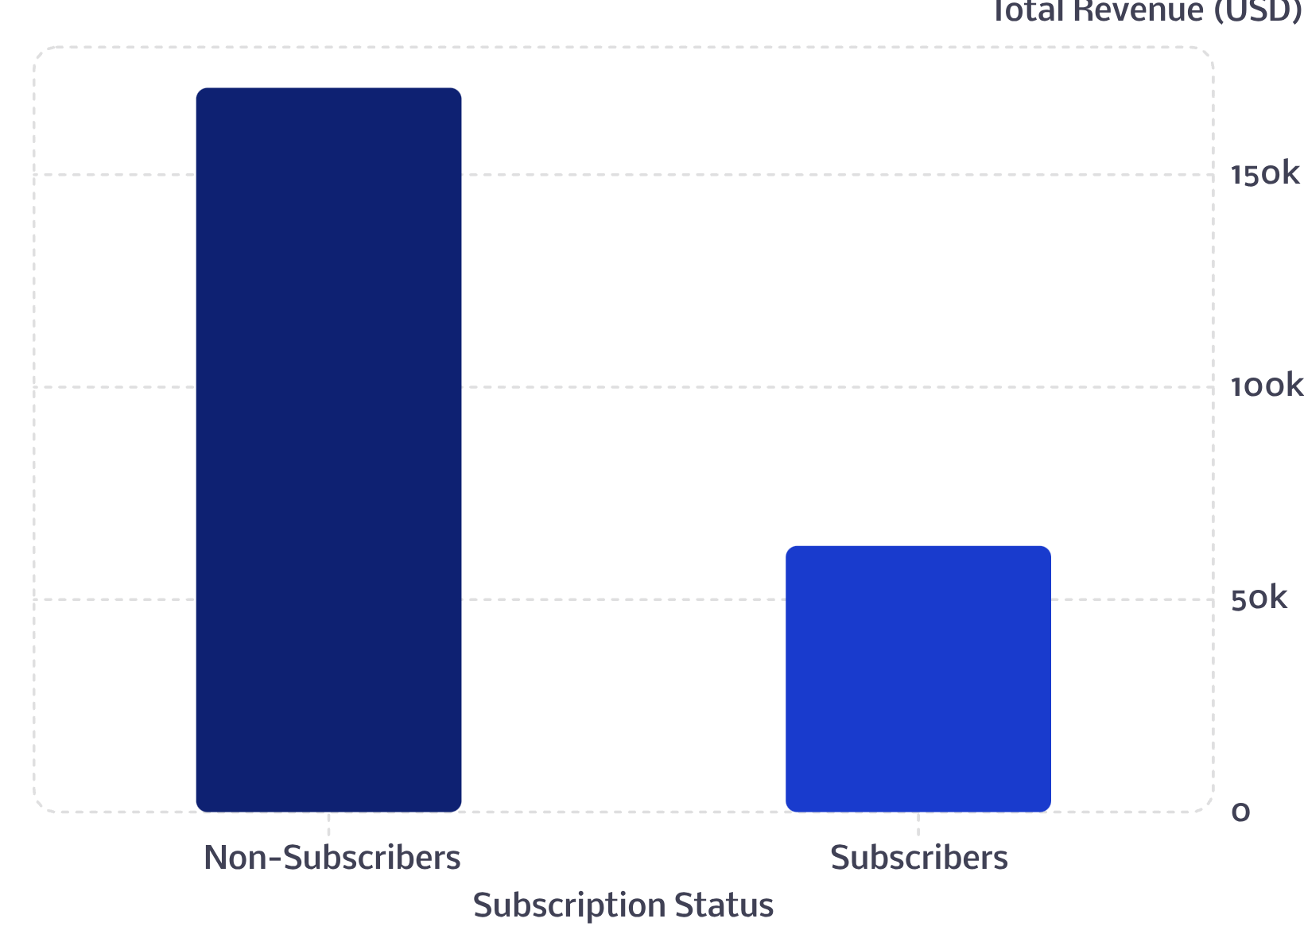

Subscribers vs. Non-Subscribers
What the Numbers Say
Non-subscribers (2,847 customers) account for 73% of the base and $170,436 in revenue.
Subscribers (1,053 customers) contribute $62,645 — a large untapped opportunity.
Average spend is nearly identical (~$59.50), meaning subscribers are just as valuable per person.

Slide 6
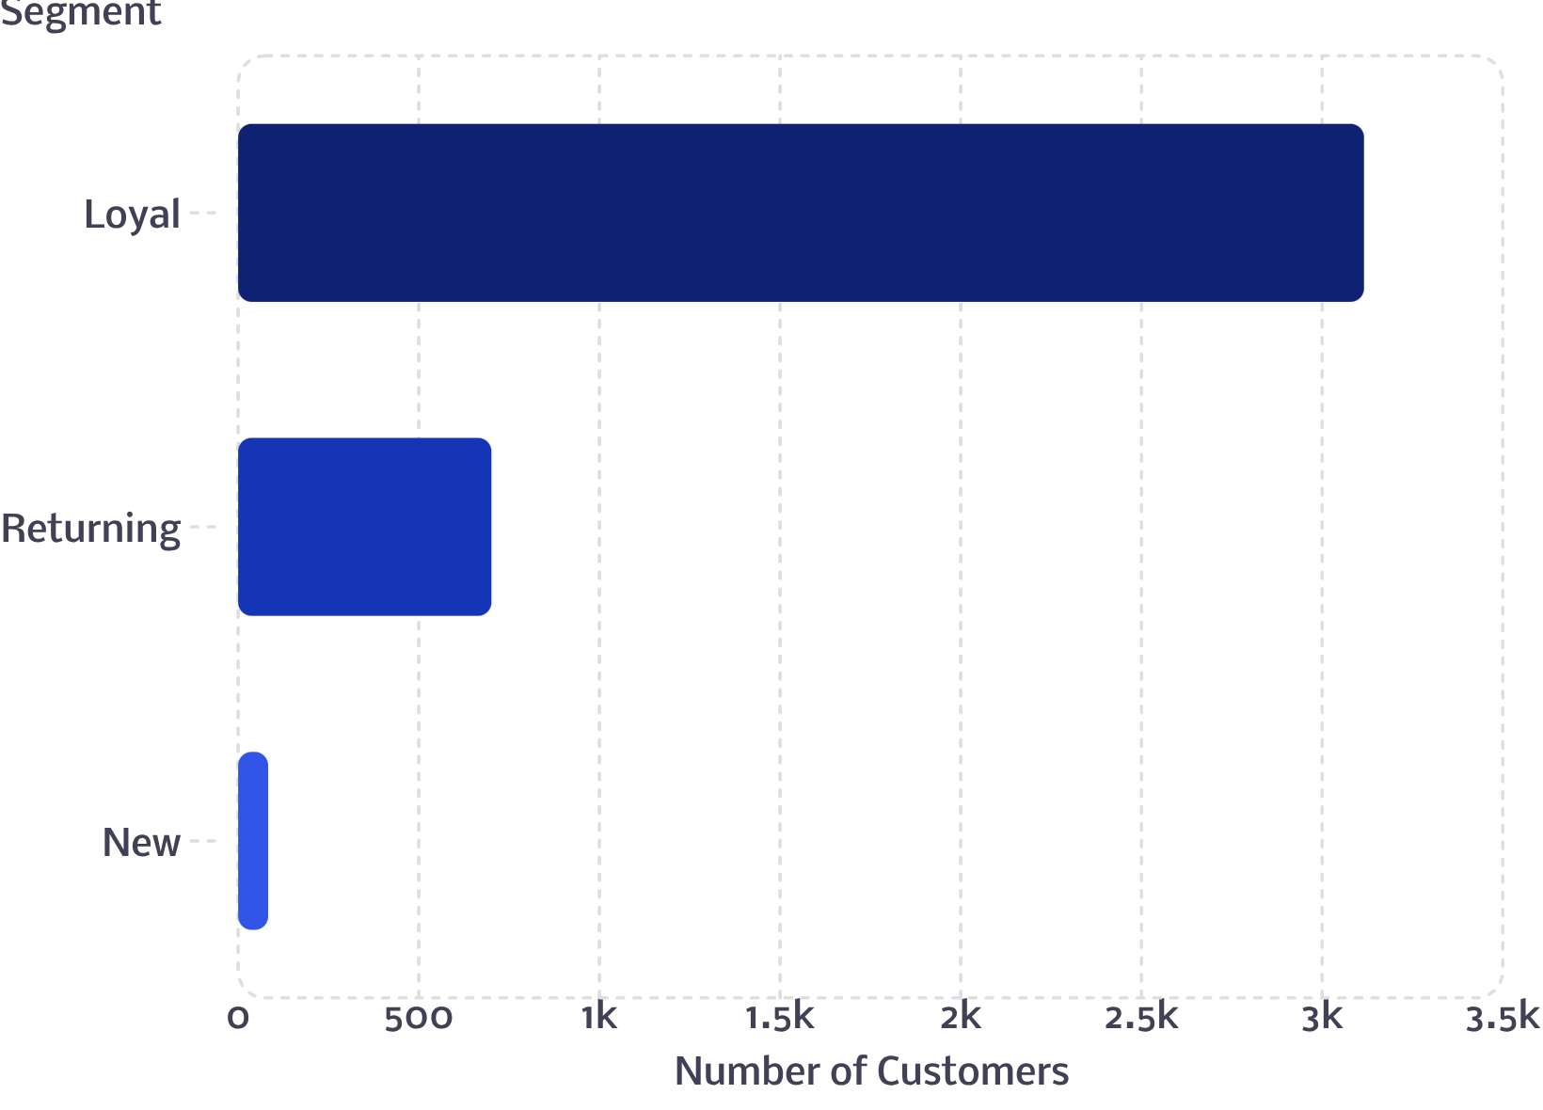
Customer Segmentation
Segment Breakdown
Customers were classified into three segments based on purchase history:
Loyal (3,116) — The vast majority, strong repeat purchase behavior
Returning (701) — Active but not yet fully loyal
New (83) — Small but important growth segment
Of customers with more than 5 purchases, 958 are subscribers vs. 2,518 non-subscribers — repeat buyers are more likely to subscribe.

Slide 7
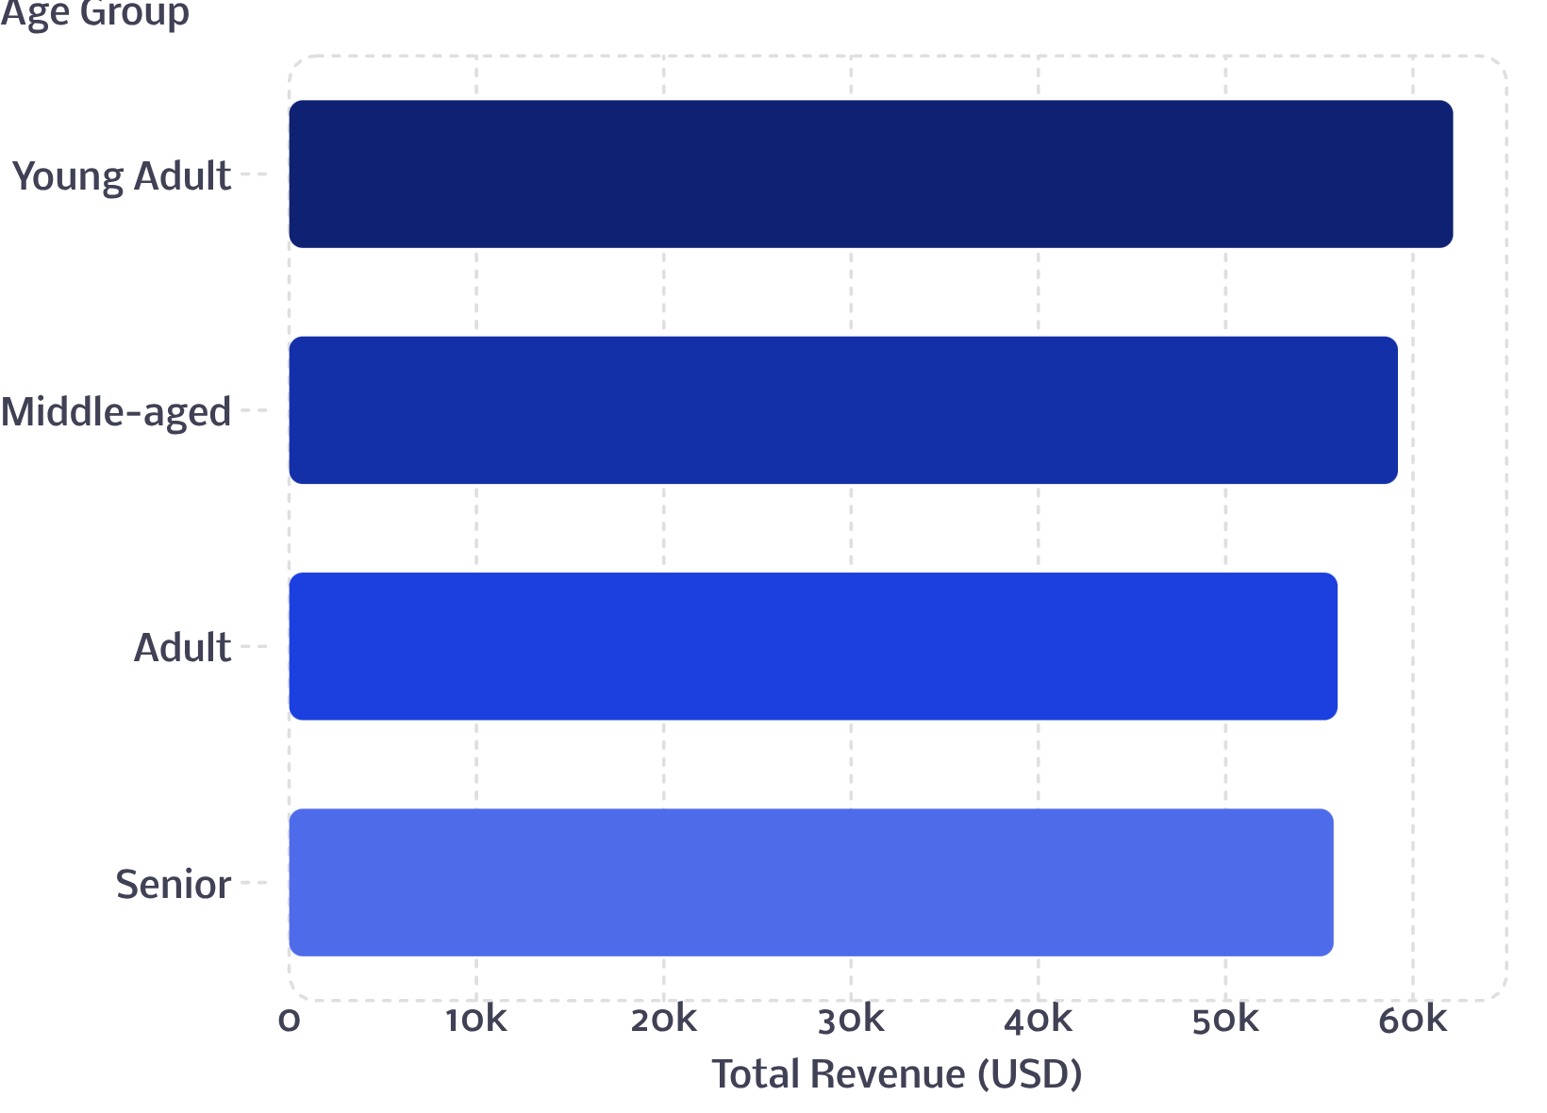
Revenue by Age Group
Age Group Insights
Revenue is relatively evenly distributed across age groups, with Young Adults leading at $62,143 and Seniors at $55,763 — a difference of only ~$6K.
All four age groups are meaningful revenue contributors, making age-targeted campaigns broadly relevant.

Slide 8
Top Products by Category & Rating
Top 3 Products per Category
Top 5 Products by Rating
Category | Product | Orders
Accessories | Jewelry | 171
Clothing | Blouse | 171
Footwear | Sandals | 160
Outerwear | Jacket | 163
Product | Avg Rating
Gloves | 3.86
Sandals | 3.84
Boots | 3.82
Hat | 3.80
Skirt | 3.78
Express shipping customers spend slightly more on average ($60.48 vs $58.46). Hat, Sneakers, and Coat have the highest discount rates (~49–50%).

Slide 9

Power BI Dashboard
An interactive Customer Behavior Dashboard was built to visualize all key insights at a glance, with filters for Subscription Status, Gender, Category, and Shipping Type.
Key Metrics
Revenue by Category
3.9K customers · $59.76 avg purchase · 3.75 avg rating
Clothing leads at $100K, followed by Accessories ($75K), Footwear ($30K), Outerwear ($15K)
Subscription Split
73% non-subscribers vs 27% subscribers

Slide 10


Business Recommendations
🔔 Boost Subscriptions
Promote exclusive subscriber benefits to convert the 73% non-subscriber base.
🏆 Loyalty Programs
Reward repeat buyers to move them into the "Loyal" segment (currently 3,116 customers).
💰 Review Discount Policy
Balance sales boosts from discounts with margin control — ~50% of Hat and Sneaker sales use discounts.
🎯 Targeted Marketing
Focus on high-revenue age groups (Young Adults lead) and express-shipping users who spend more.

